Slide 1
CS-202: Final Project Proposal
PwdManLib
Author: Tyler Moore
(A DevOpSec production)

Slide 2
Problem:
Crypto / OpSec is hard to implement
There is no standard approach
Users are exposed to data-loss, identity theft, and financial issues
Exploits are more prevalent in web-development

Slide 3
Problem:
In 2015 there were nine mega-breaches
Reported number of exposed identities 429 million
Estimated unreported breaches pushes the number of records lost to more than half a billion
-Stats courtesy of (Symantec 2017)

Slide 4
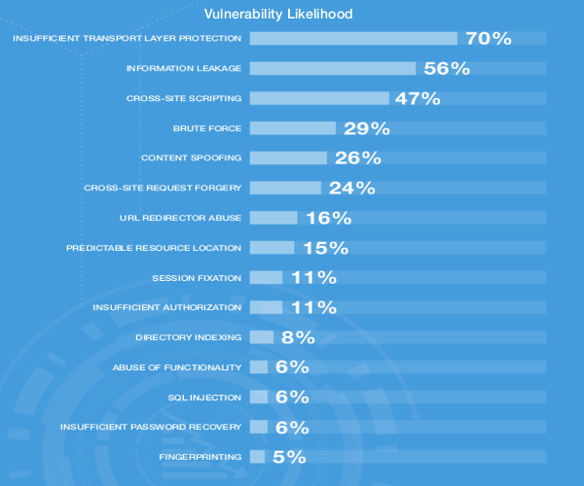
Problem:
White Hat
Security Report
(2015)

Slide 5
Solution:
Abstraction of user account management
Through libraries that developers can easily integrate in project
Leave the crypto to the pros (field-tested libraries included)
Make it cross-platform so any architecture could use them

Slide 6
Mission:
To make a set security tools that is tested and confirmed by the community
This project aims to implement a set of C/C++ libraries for developers to use in user / accnt password management / auth
These tools are aimed at making user / account management easier for developers to implement in their projects
To share these tools with the community at NO COST

Slide 7
Alternatives:
Some of the alternative solutions / similar projects are:
Flask-Login / Flask-Security
PHPSEC Password Management
Google Keyczar
Java crypto.spec
Master Password
Our solution addresses each of these issues in independent libraries that together, fill the “gaps” leading to zero-days
These solutions lack the abstraction layers, extensibility, and platform-compatibility necessary to solve the overall problem

Slide 8
Project Timeline:
This project is broken into week blocks (starting Feb 13) and culminating with an initial alpha release PwdManLib_1.0.0A
Week1:
Finish documentation for project and define initial project structure / architecture
Week2:
Define dependencies and framework / platforms that will be supported
Start construction of hashing and encryption utilities
Week3:
Test and debug hashing / encryption utils
Define interfaces for framework communication and adapters as needed.
Define network architecture and start construction of interfaces.

Slide 9
Project Timeline:
Week4:
Construction of network interfaces continues and plugins
Define authentication methods for initial release and start construction of auth libraries
Week5:
Test and debug network libraries, auth libraries, and interface libraries
Thorough vetting of auth process occurs.
Define methods and routines needed for password recovery and captcha verification.
Week6:
Finish / close out any outstanding issues and ensure all major bugs are fixed
Test, debug, and confirm all functionalities for initial release / requirements are met Code cleanup and documentation additions as needed
Minor bug fixes if time permits.

Slide 10
High-level Plan
Overview of key system design concepts are listed below:
Password hashes, salts, and accounts should be stored on remote / cloud DB
Must support ssl / https and other encrypted networking protocols (ipsec)
Libraries should include support for authentication including multifactor auth
Support for time-limited token-based automated password recovering (by email)
Support for captcha and account lockout handling

Slide 11

High-level Plan
Overview of key system design concepts are listed below:
Multiple forms of encryption should be available including:
standard encryption algorithms: Triple DES, RSA, Blowfish, Twofish, AES
Support for hashing passwords must be included, using:
standard hashing algorithms: SHA256, SHA512, RipeMD, or WHIRLPOOL algorithms
Support for hashing passwords with key-stretching algorithms:
standard key-streching hash-algorithms: PBKDF2, bcrypt, scrypt, Argon2, PBKDF2

Slide 12
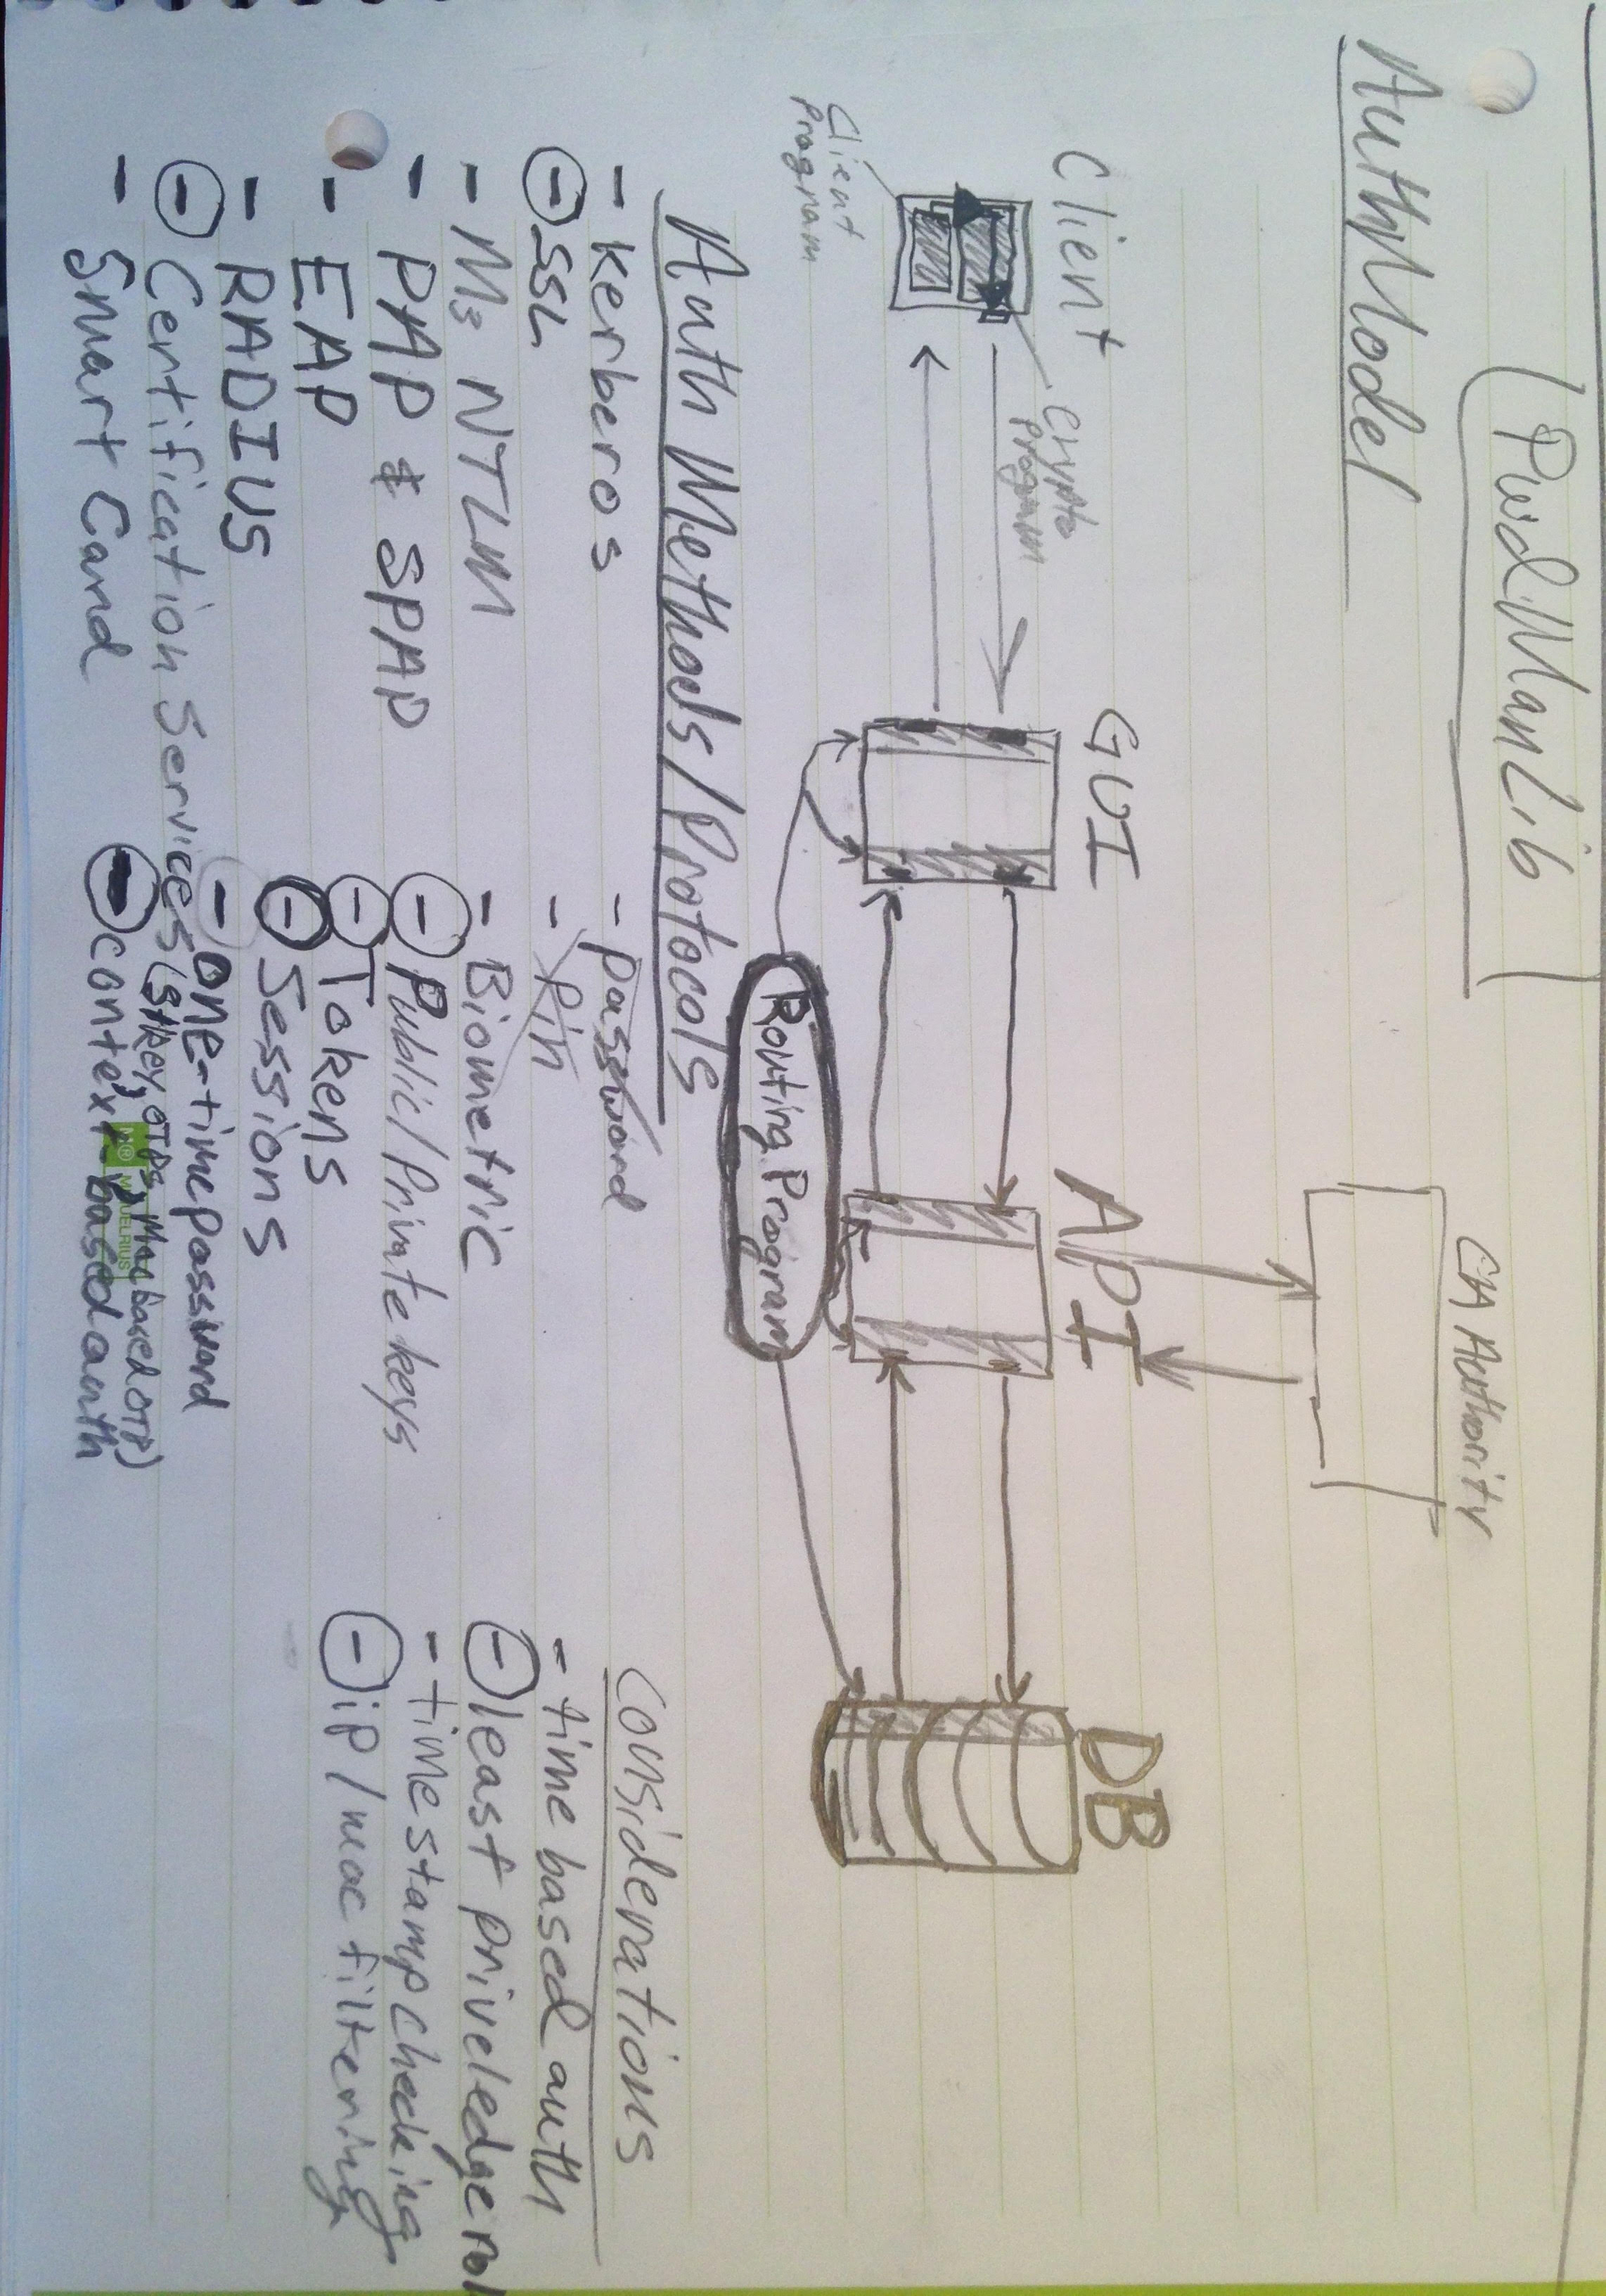
Auth Model

Slide 13
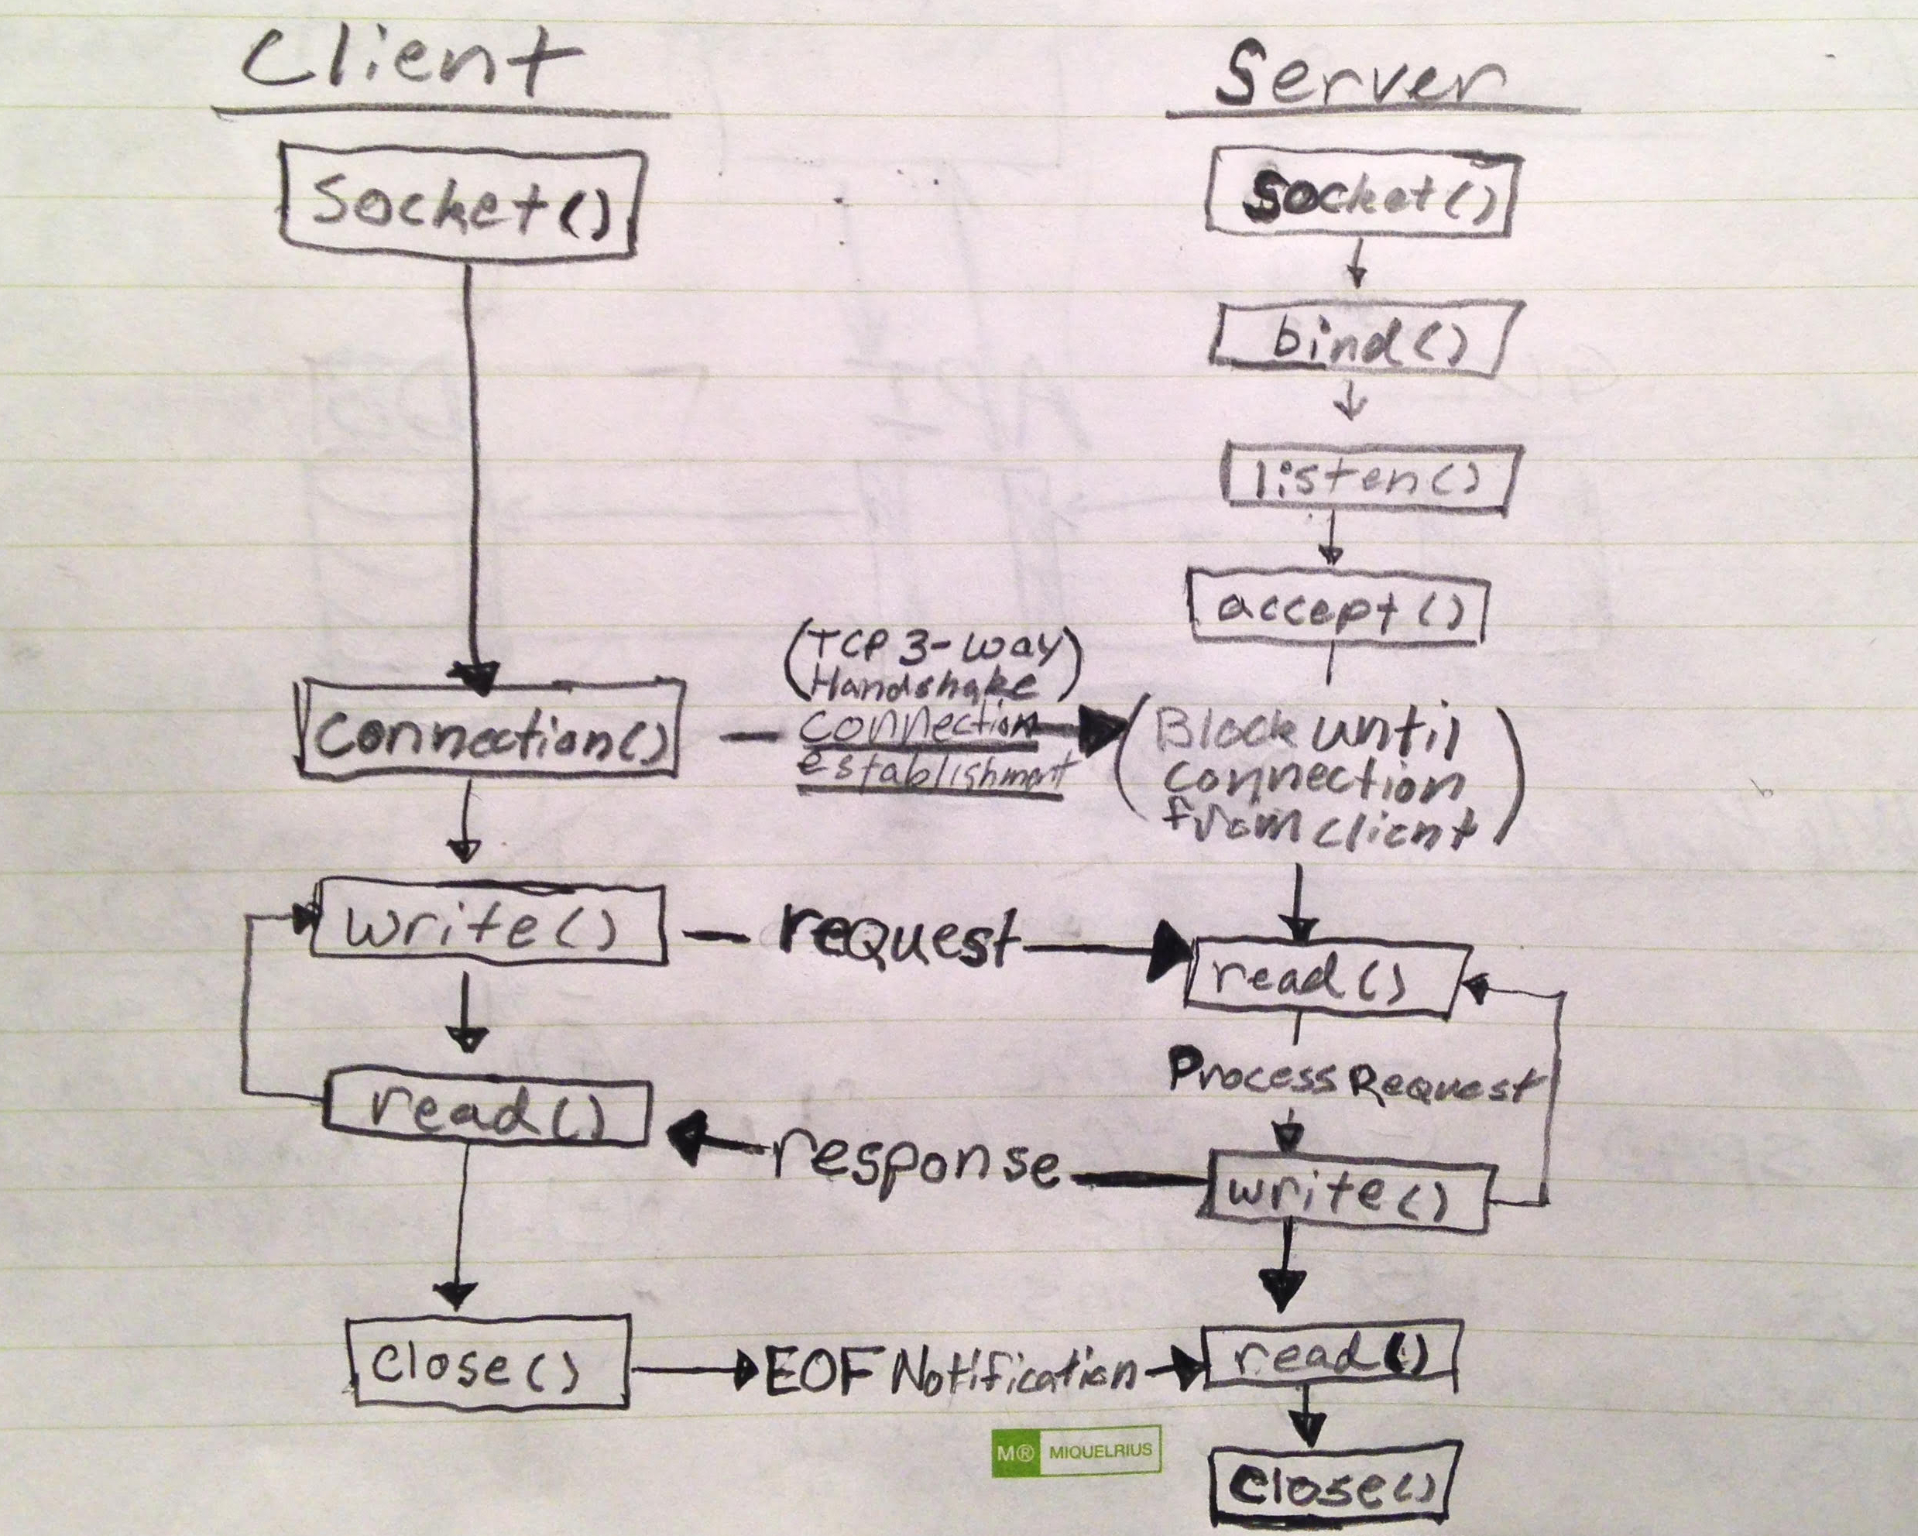
TCP-Socket Model

Slide 14
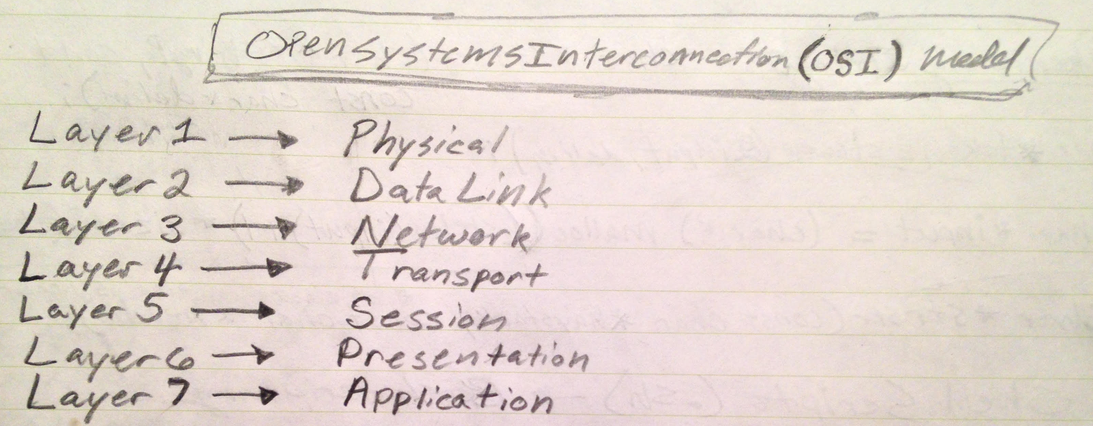
OSI Network Standard

Slide 15
References
Links to Project Resources
PwdManLib Github:
DevOpSec Website:
Links to Research Material
Symantec:
WhiteHat Security:
https://github.com/devopsec/pwdmanlib
https://devopsec.net
https://www.symantec.com/security-center/threat-report
https://info.whitehatsec.com/rs/whitehatsecurity/images/2015-Stats-Report.pdf

